Slide 1
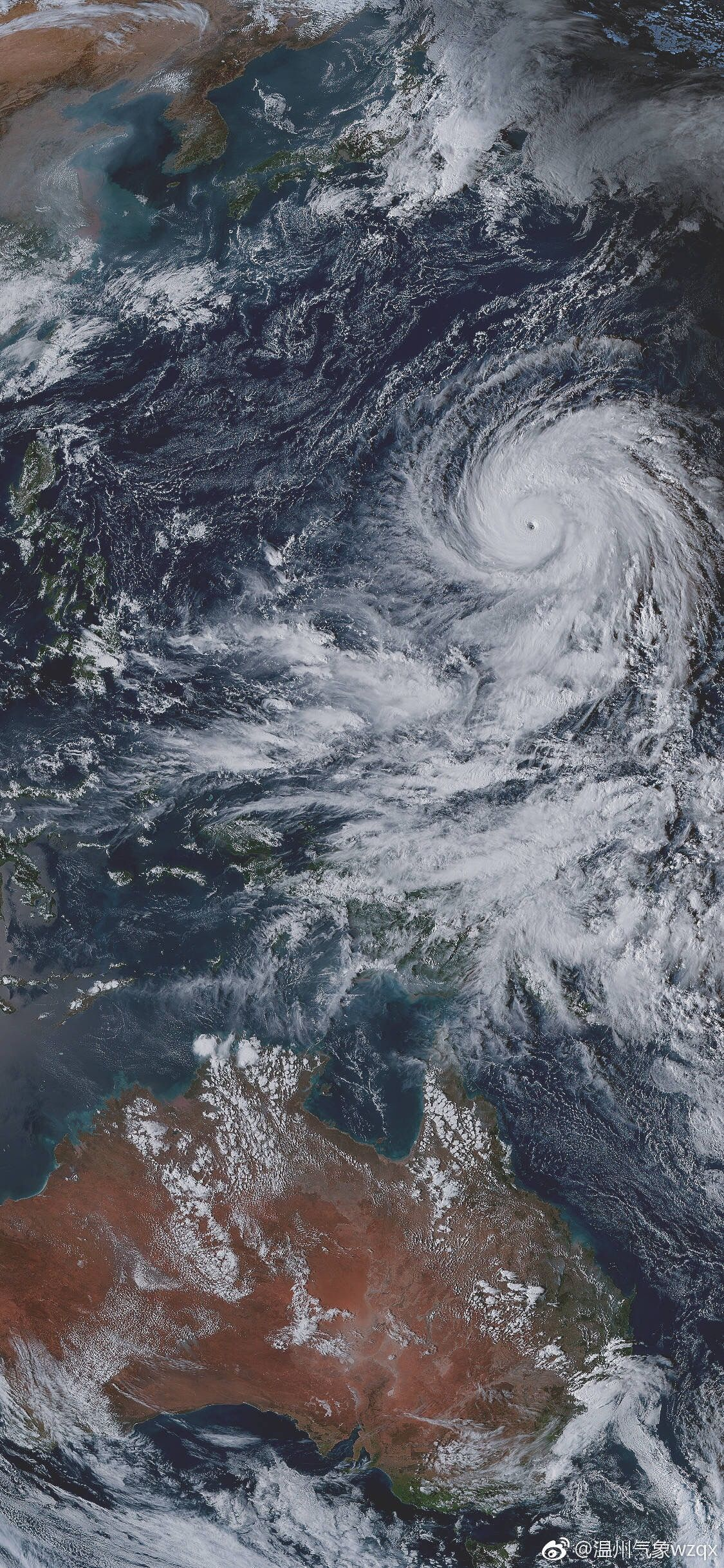
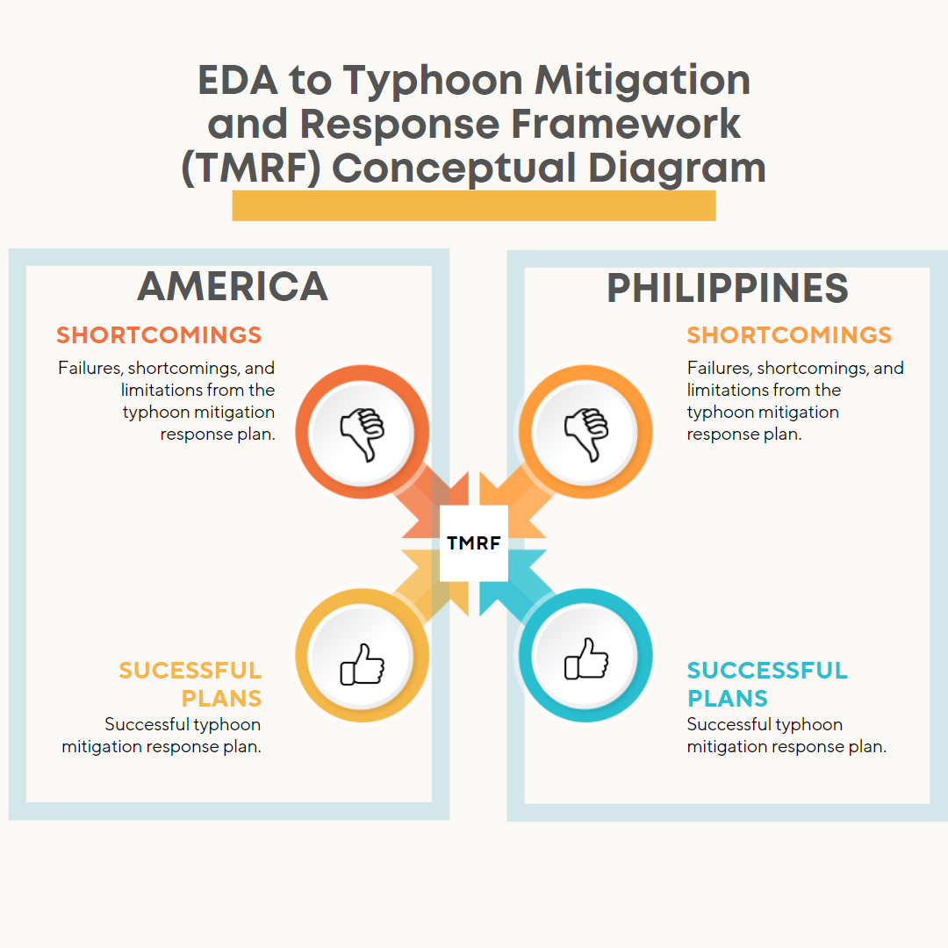
EDA to Typhoon Mitigation and Response Framework (TMRF)
Presented by:
TEAM TYPHOON ANALYST
Alvaro, Gabriel Edrian
Palis, John Arthur
Alangilan, Christine Joy
Guerra, Marian

Slide 2
DID YOU KNOW?
20
APPROXIMATELY
Twenty tropical cyclones pass through the Philippine Area of Responsibility per year

Slide 3
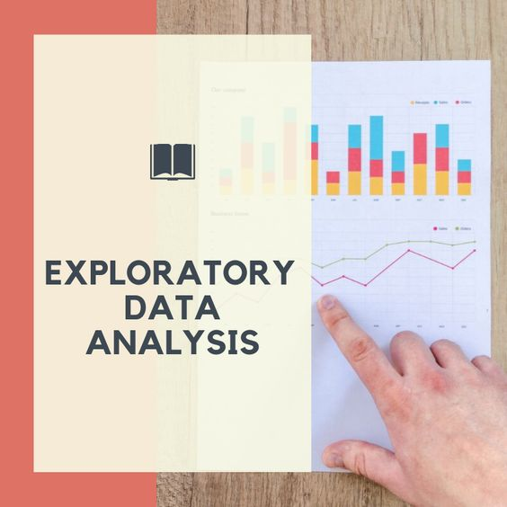
TOPICS AND HIGHLIGHTS
Sustainable Development Goals
Introduction
Problem Statement
Objectives
Purpose
Sources of Datasets

Slide 4



Goal 11: Sustainable Cities and Communities
Sustainable Development Goals
It stives to mitigate the negative consequences of natural catastrophes like typhoons.
Goal 13: Climate Action
It stives to take immediate action to address climate change and its consequences.
Goal 15: Life on Land
It seeks to manage forest sustainability, prevent desertification, halt and reverse land degradation, and halt biodiversity loss.

Slide 5
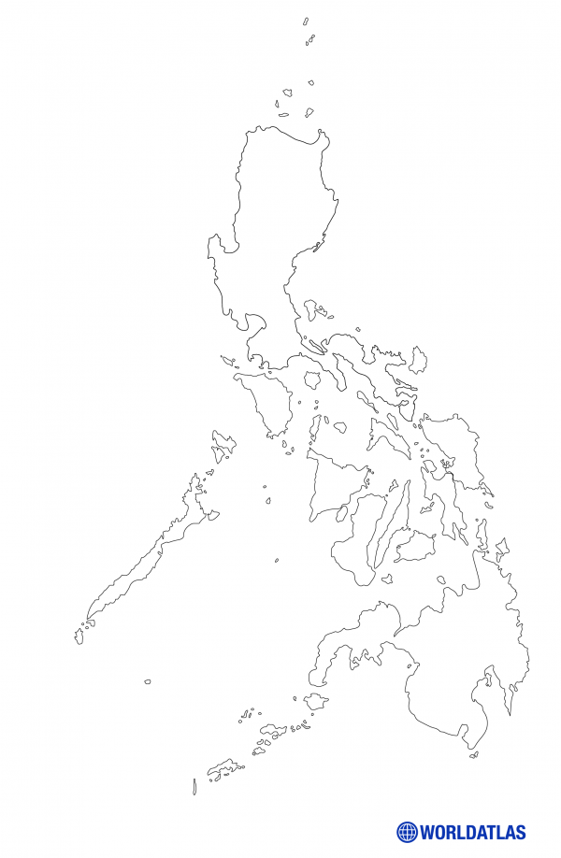
EDA TO TMRF INTRODUCTION
The Philippines' apparent vulnerability to natural disasters emerges from its geographic location within the Pacific Ring of Fire.

Slide 6
PROBLEM STATEMENT

Slide 7
OBJECTIVES
Humanitarian Data Exchange Data set about Philippines (2019)
Objective 1
Objective 2
Objective 3
The Centre for Research on the Epidemiology of Disasters' Data set about the American Typhoons (2000-2022)

Slide 8
01.
OBJECTIVES
Humanitarian Data Exchange Data set about Philippines (2019)
Objective 1
Objective 2
Objective 3
The Centre for Research on the Epidemiology of Disasters' Data set about the American Typhoons (2000-2022)

Slide 9
OBJECTIVES
Humanitarian Data Exchange Data set about Philippines (2019)
GRAPH
Objective 1
Objective 2
Objective 3
The Centre for Research on the Epidemiology of Disasters' Data set about the American Typhoons (2000-2022)

Slide 10
OBJECTIVES
Humanitarian Data Exchange Data set about Philippines (2019)
GRAPH
Objective 1
Objective 2
Objective 3
The Centre for Research on the Epidemiology of Disasters' Data set about the American Typhoons (2000-2022)

Slide 11
02.
OBJECTIVES
Humanitarian Data Exchange Data set about Philippines (2019)
Objective 1
Objective 2
Objective 3
The Centre for Research on the Epidemiology of Disasters' Data set about the American Typhoons (2000-2022)

Slide 12
OBJECTIVES
GRAPH
Humanitarian Data Exchange Data set about Philippines (2019)
Objective 1
Objective 2
Objective 3
The Centre for Research on the Epidemiology of Disasters' Data set about the American Typhoons (2000-2022)

Slide 13
03.
OBJECTIVES
Humanitarian Data Exchange Data set about Philippines (2019)
Objective 1
Objective 2
Objective 3
The Centre for Research on the Epidemiology of Disasters' Data set about the American Typhoons (2000-2022)

Slide 14
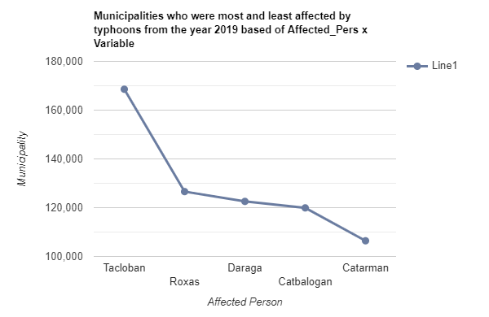
OBJECTIVES
GRAPH
Humanitarian Data Exchange Data set about Philippines (2019)
Objective 1
Objective 2
Objective 3
The Centre for Research on the Epidemiology of Disasters' Data set about the American Typhoons (2000-2022)

Slide 15
OBJECTIVES
Humanitarian Data Exchange Data set about Philippines (2019)
The Centre for Research on the Epidemiology of Disasters' Data set about the American Typhoons (2000-2022)
Objective 1
Objective 2
Objective 3
Objective 4
Objective 5

Slide 16
01.
OBJECTIVES
Humanitarian Data Exchange Data set about Philippines (2019)
The Centre for Research on the Epidemiology of Disasters' Data set about the American Typhoons (2000-2022)
Objective 1
Objective 2
Objective 3
Objective 4
Objective 5

Slide 17

OBJECTIVES
GRAPH
Humanitarian Data Exchange Data set about Philippines (2019)
The Centre for Research on the Epidemiology of Disasters' Data set about the American Typhoons (2000-2022)
Objective 1
Objective 2
Objective 3
Objective 4
Objective 5
HURRICANE
IRMA

Slide 18
OBJECTIVES
GRAPH
Humanitarian Data Exchange Data set about Philippines (2019)
The Centre for Research on the Epidemiology of Disasters' Data set about the American Typhoons (2000-2022)
Objective 1
Objective 2
Objective 3
Objective 4
Objective 5

Slide 19
02.
OBJECTIVES
Humanitarian Data Exchange Data set about Philippines (2019)
The Centre for Research on the Epidemiology of Disasters' Data set about the American Typhoons (2000-2022)
Objective 1
Objective 2
Objective 3
Objective 4
Objective 5

Slide 20
OBJECTIVES
GRAPH
Humanitarian Data Exchange Data set about Philippines (2019)
The Centre for Research on the Epidemiology of Disasters' Data set about the American Typhoons (2000-2022)
Objective 1
Objective 2
Objective 3
Objective 4
Objective 5

Slide 21
03.
OBJECTIVES
Humanitarian Data Exchange Data set about Philippines (2019)
The Centre for Research on the Epidemiology of Disasters' Data set about the American Typhoons (2000-2022)
Objective 1
Objective 2
Objective 3
Objective 4
Objective 5

Slide 22
OBJECTIVES
GRAPH
Humanitarian Data Exchange Data set about Philippines (2019)
The Centre for Research on the Epidemiology of Disasters' Data set about the American Typhoons (2000-2022)
Objective 1
Objective 2
Objective 3
Objective 4
Objective 5

Slide 23
04.
OBJECTIVES
Humanitarian Data Exchange Data set about Philippines (2019)
The Centre for Research on the Epidemiology of Disasters' Data set about the American Typhoons (2000-2022)
Objective 1
Objective 2
Objective 3
Objective 4
Objective 5

Slide 24
OBJECTIVES
GRAPH
Humanitarian Data Exchange Data set about Philippines (2019)
The Centre for Research on the Epidemiology of Disasters' Data set about the American Typhoons (2000-2022)
Objective 1
Objective 2
Objective 3
Objective 4
Objective 5

Slide 25
05.
OBJECTIVES
Humanitarian Data Exchange Data set about Philippines (2019)
The Centre for Research on the Epidemiology of Disasters' Data set about the American Typhoons (2000-2022)
Objective 1
Objective 2
Objective 3
Objective 4
Objective 5

Slide 26
OBJECTIVES
Humanitarian Data Exchange Data set about Philippines (2019)
The Centre for Research on the Epidemiology of Disasters' Data set about the American Typhoons (2000-2022)
Objective 1
Objective 2
Objective 3
Objective 4
Objective 5

Slide 27
Source of Datasets

Slide 29

MEET THE TEAM
TEAM TYPHOON ANALYST
Gabriel Alvaro
Project Manager
John Palis
Presentation Manager
Christine Alangilan
Documentation Director
Marian Guerra
Quality Assurance Analyst

